Slide 1

Digital Image Processing
A project by Rana Ali Husnain, Muhammad Zeeshan Islam, Imran Saleem, and Umair Tahir from Superior University's BSCS 5th Semester, Department of Computer Sciences.

Slide 2
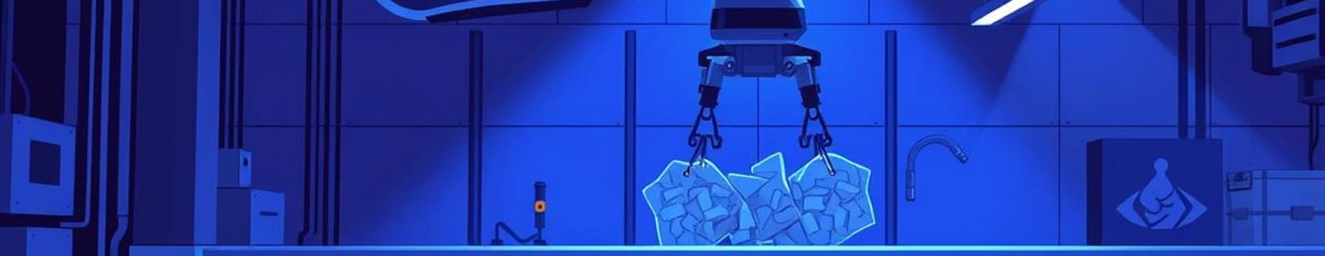
Plastic Objects Detection System
This project utilizes YOLOv11 for plastic object detection, aiming to enhance waste management, recycling automation, and environmental monitoring. It includes an interactive Streamlit web application for user-friendly interaction.

Slide 3




Project Objectives
Detect Plastic Waste
Interactive UI
Identify multiple types of plastic waste using YOLOv11.
Create a simple and interactive user interface for end-users.
Real-time Detection
Deep Learning Application
Enable real-time object detection using a webcam.
Demonstrate AI's role in environmental sustainability.

Slide 4

Technologies Used
Deep Learning & Computer Vision
Web App & Language
Streamlit: For creating the web-based UI.
YOLOv11: For object detection.
Python 3.10+: Programming language.
OpenCV: For video streaming (webcam).
Numpy & Matplotlib: For data handling and visualization.
PyTorch: For model execution.

Slide 5




Core Concepts
Object Detection
Transfer Learning
Identifies objects, draws bounding boxes, and predicts classes with confidence scores.
Fine-tunes pre-trained YOLOv11 weights on a plastic waste dataset for accuracy.
Streamlit Integration
Real-time Processing
Wraps the model in an easy-to-use UI for image upload and real-time processing.
Processes webcam frames with OpenCV + YOLOv11 for instant predictions.

Slide 6
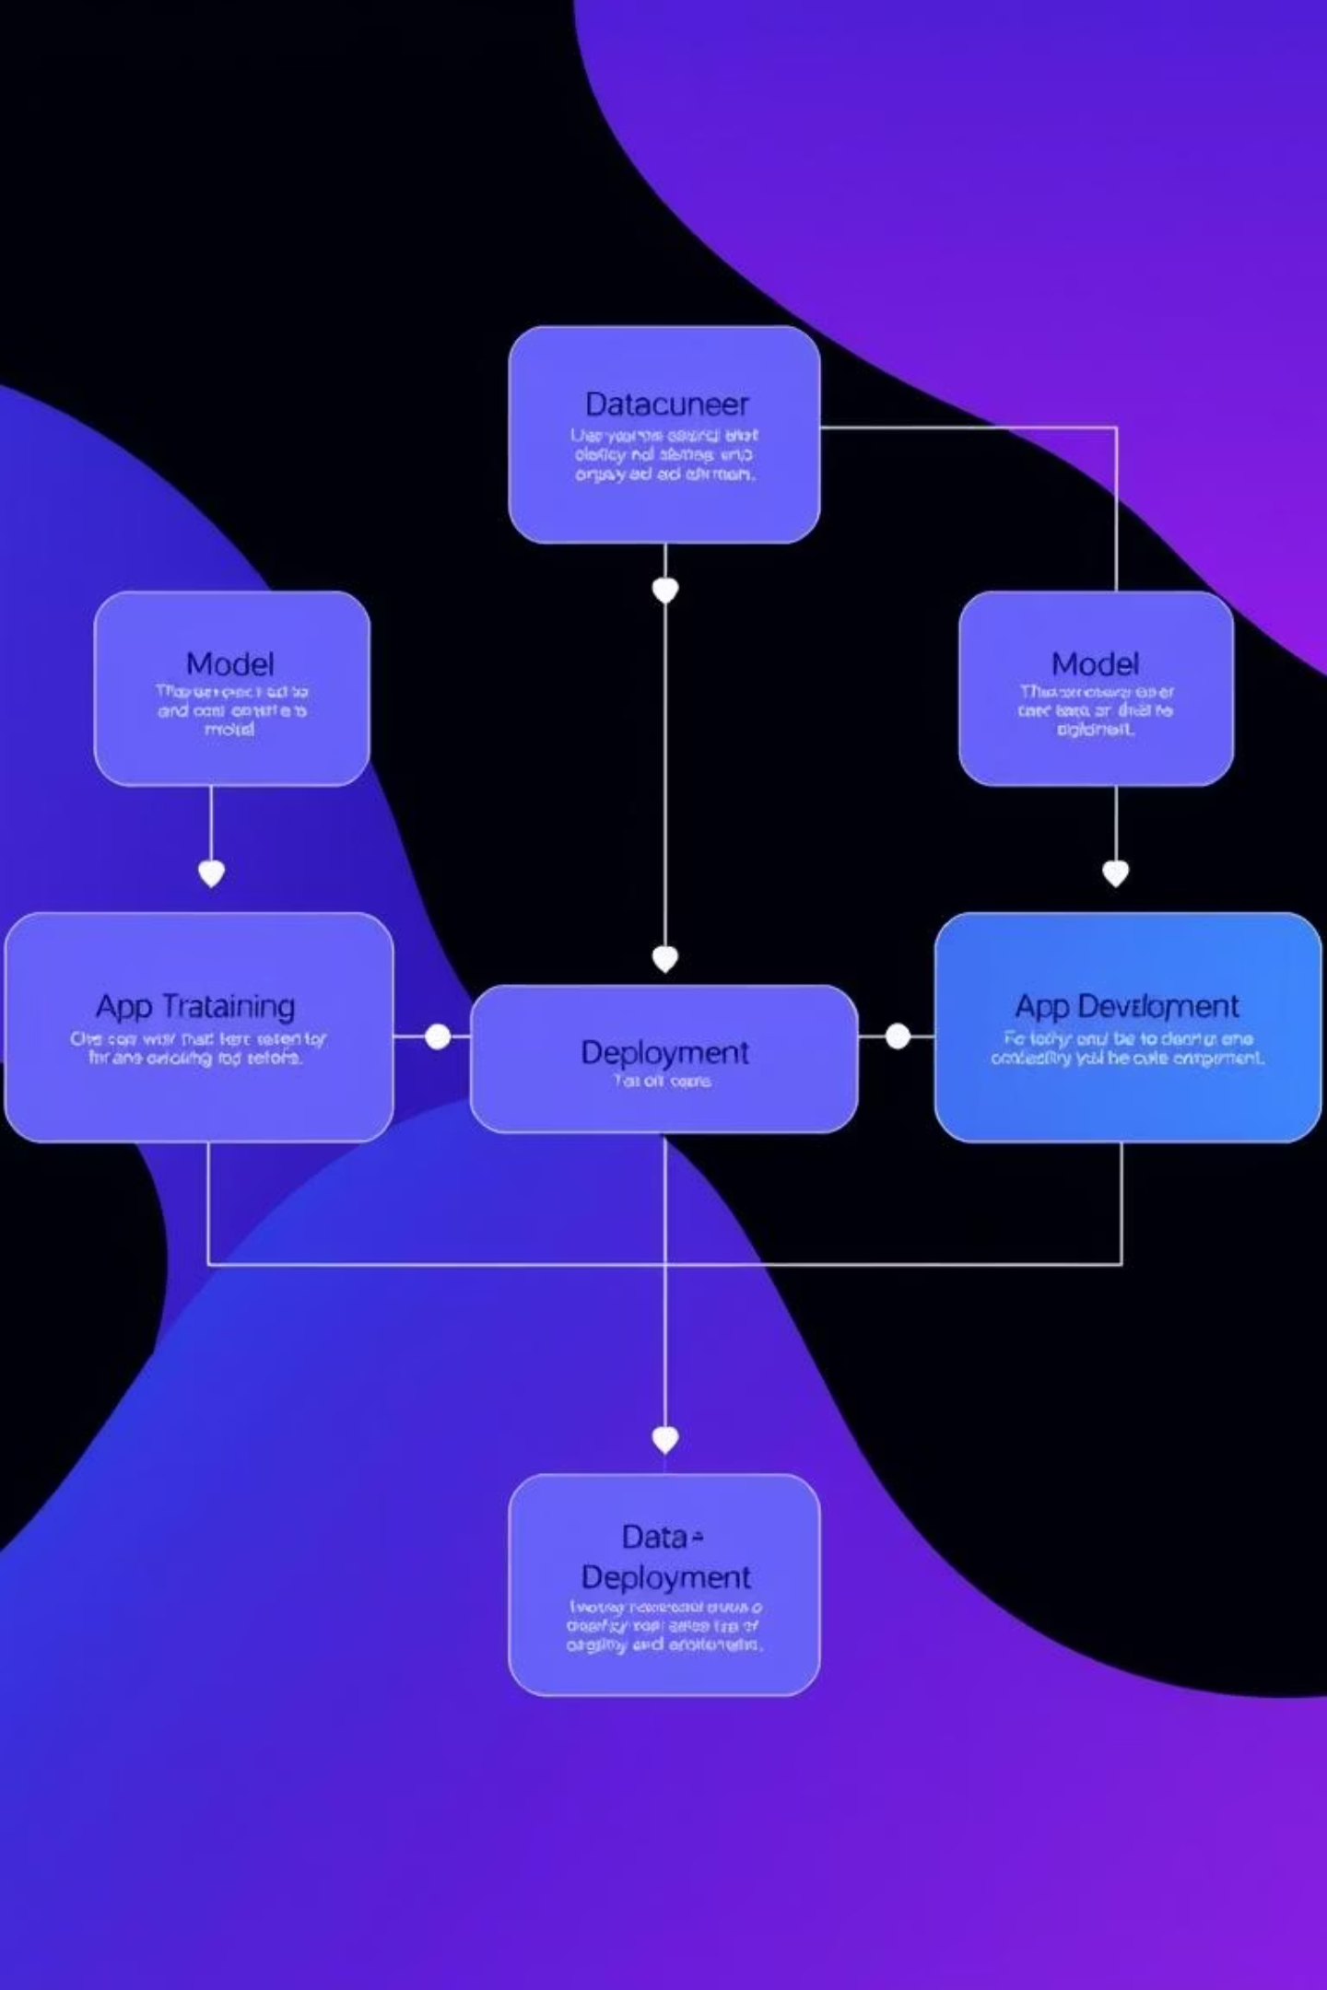
System Workflow
01
Data Acquisition
Utilize a labeled plastic waste dataset from Kaggle.
02
Model Training
Train YOLOv11 locally with custom data; download final weights (best.pt).
03
Streamlit App Development
Develop UI modules for main interface, image upload, and real-time webcam detection.
04
Deployment
Run the application locally using streamlit run app.py.

Slide 7
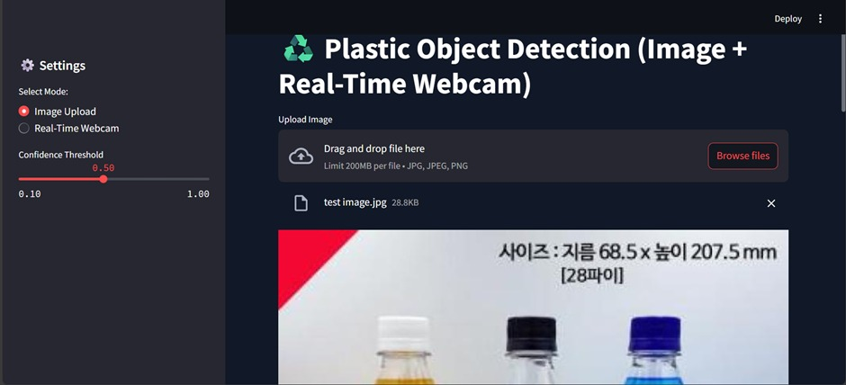
Application Interface
Users can select between "Image Upload" or "Real-Time Webcam" modes and adjust the confidence threshold.
The Streamlit app provides a clean interface for plastic object detection.

Slide 8
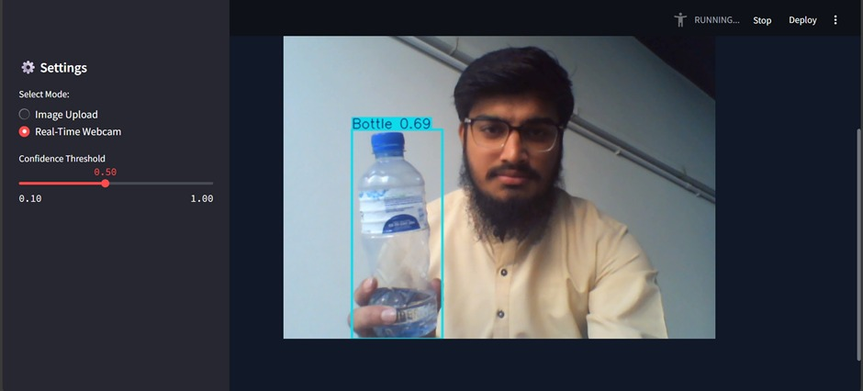
Detection in Action
Image Upload Detection
Real-Time Webcam Detection
The system accurately identifies plastic bottles in uploaded images, providing bounding boxes and confidence scores.
Real-time detection processes live webcam feeds, instantly identifying plastic objects like bottles with high confidence.
Real-time detection processes live webcam feeds, instantly identifying plastic objects like bottles with high confidence.

Slide 9



Results & Conclusion
Successful Detection
Smooth Real-time
Professional UI
YOLOv11 accurately detects multiple plastic items.
Real-time detection runs smoothly without GPU.
Streamlit UI ensures ease of use and professional presentation.
This project showcases how AI and computer vision can significantly contribute to waste classification and environmental protection, offering a complete and production-ready solution.

Slide 10





Future Enhancements
Cloud Deployment
For online accessibility.
More Waste Classes
Expand detection capabilities.
Voice Alerts
For detected objects.
Object Tracking
Implement advanced tracking features.
Mobile Version
Develop a portable model.
Prepared by: Ali-122 (Leader), Zeeshan-548, Umair-393, Imran-365

